Slide 1






The National Cancer Atlas
Susanna Cramb
susannacramb@cancerqld.org.au

Slide 2
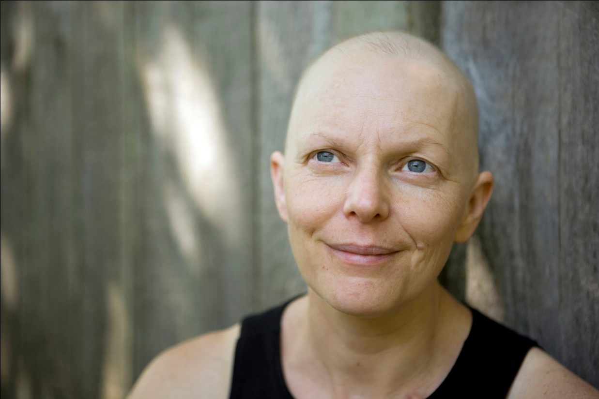
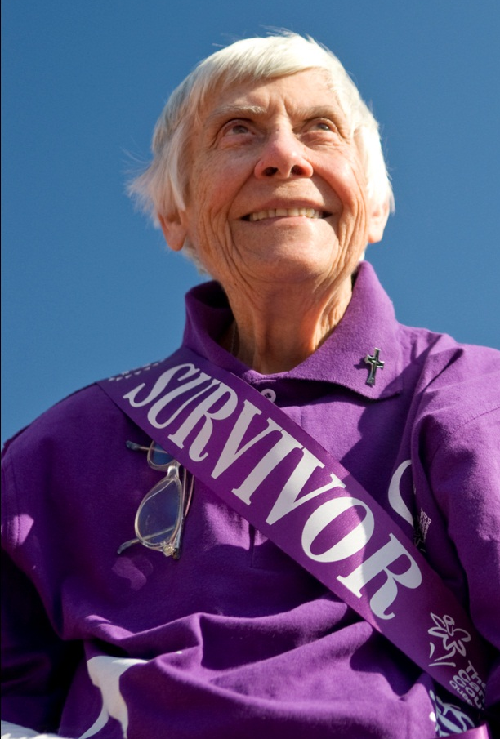
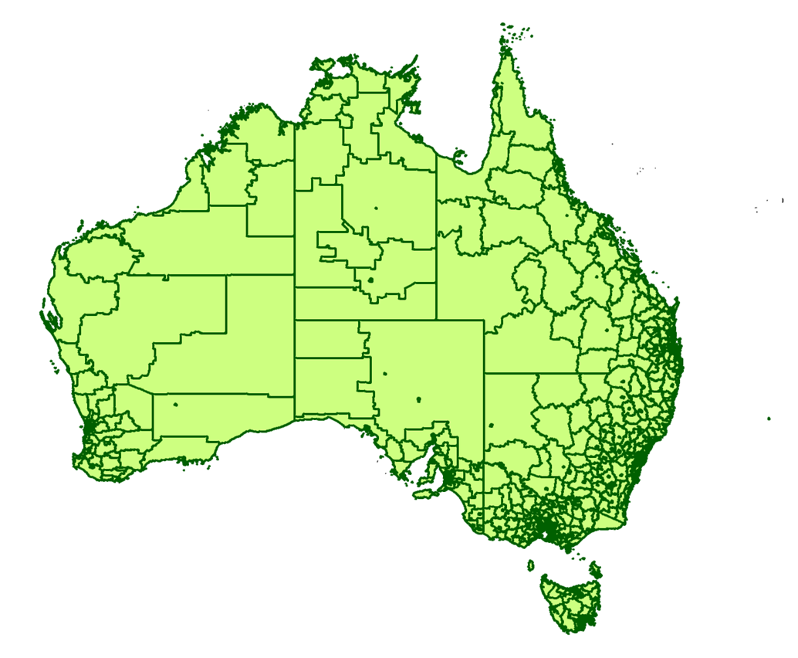
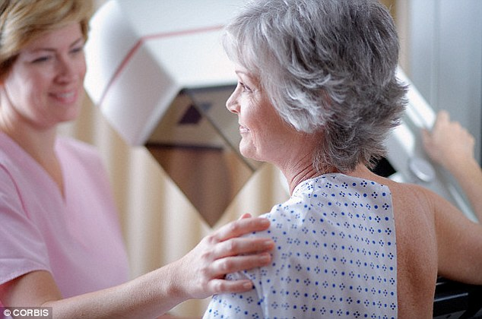

Notes:
Cancer incidence and survival will be examined for around 20 of the leading cancers at the level of (click) statistical area 2, or SA2s. We also plan to examine spatial patterns in screening participation for population-based screening programs such as (click) mammograms for breast cancer, FOBT for bowel cancer and Pap Tests for cervical cancer.

Slide 3

So what?
First time to examine small-area variation in cancer outcomes across Australia
Will identify areas with less than optimal outcomes
Can underpin advocacy efforts

Slide 4

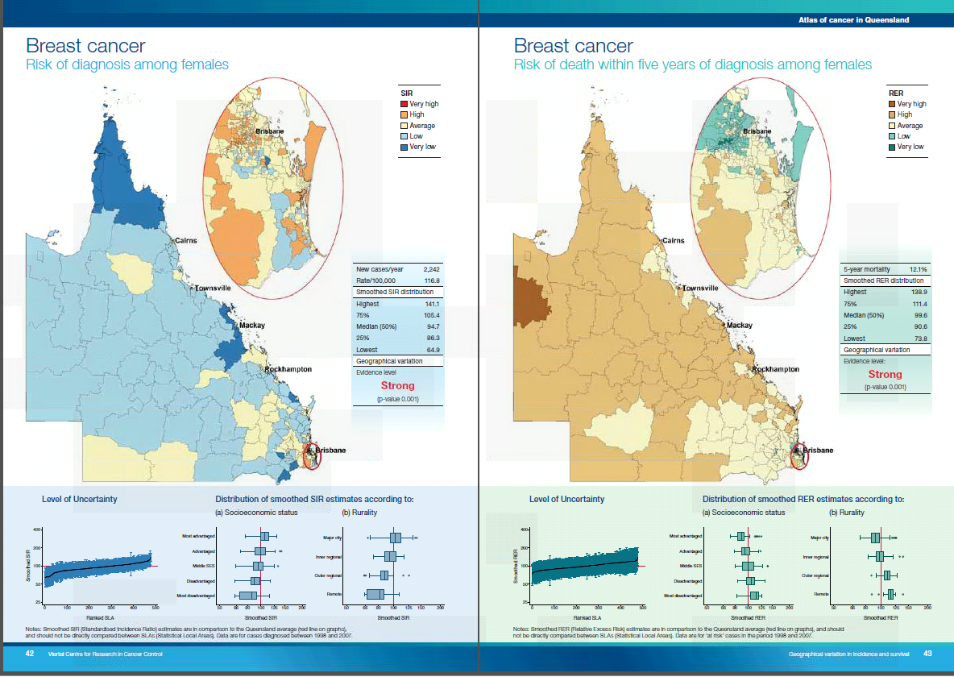
Notes:
And this work was published in a report where we examined around 20 of the leading cancer types. You are very welcome to take a copy if you are interested in seeing all the results.

Slide 5
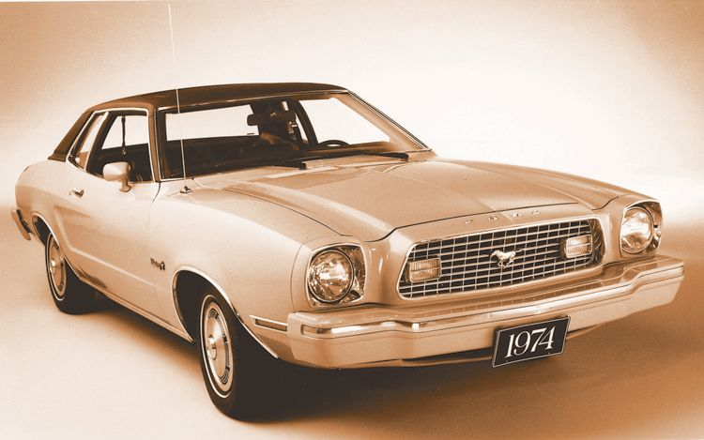
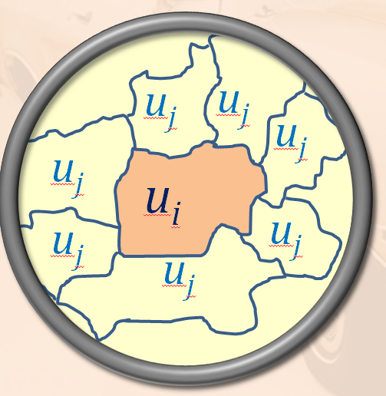
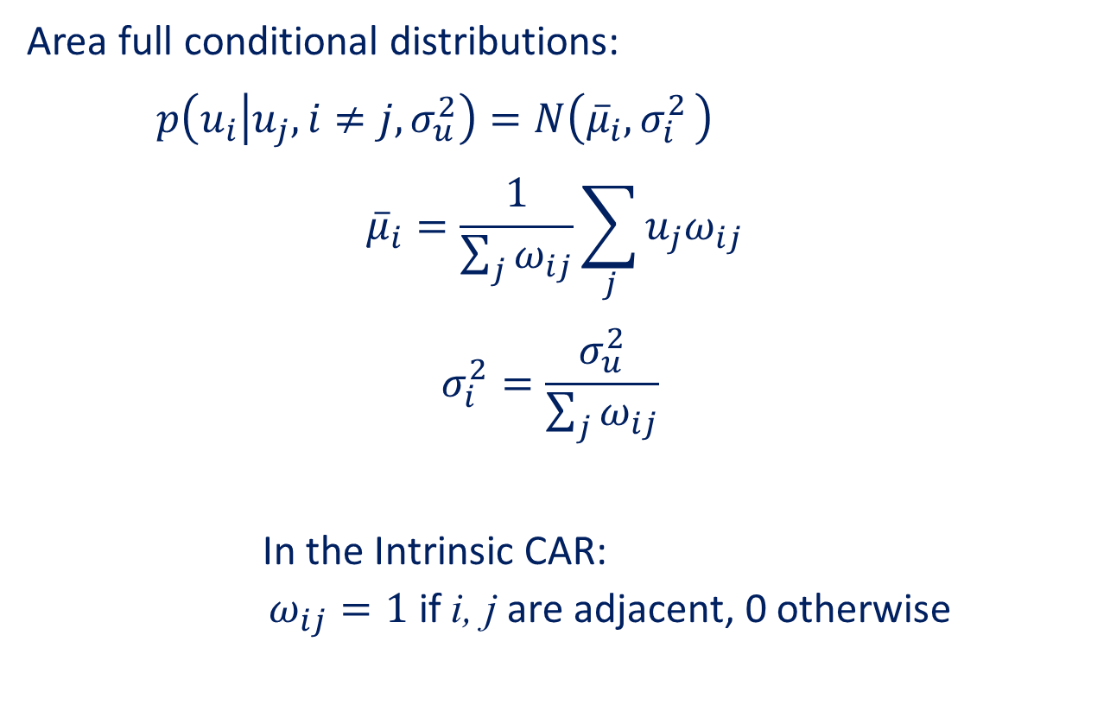
The Conditional AutoRegressive (CAR) distribution
Area full conditional distributions:
$$p\left(u_{i} | u_{j},i≠j,σ_{u}^{2}\right)=N\left({\overline{μ}}_{i}{, σ}_{i}^{2}\right)$$
$${\overline{μ}}_{i}=\frac{1}{\sum_{j}{ω_{ij}}}\sum_{j}{u_{j}ω_{ij}}$$
$$σ_{i}^{2}=\frac{σ_{u}^{2}}{\sum_{j}{ω_{ij}}}$$
In the Intrinsic CAR:
$$ω_{ij}=1 \text{if} \text{i}\text{, }\text{j} \text{are} \text{adjacent}\text{, 0 }\text{otherwise}$$
Notes:
Such as the intrinsic conditional autoregressive, or CAR, distribution. Here we define neighbours based on adjacency. So in our diagram, the orange area has neighbours with all the areas containing j subscripts. Each neighbour is given a weight of 1, while any region that is not a neighbour has a weight of 0. So effectively, the mean then becomes an average over the neighbouring areas, and our variance is divided by the number of neighbours. This prior assumes that nearby areas are NOT independent.

Slide 6
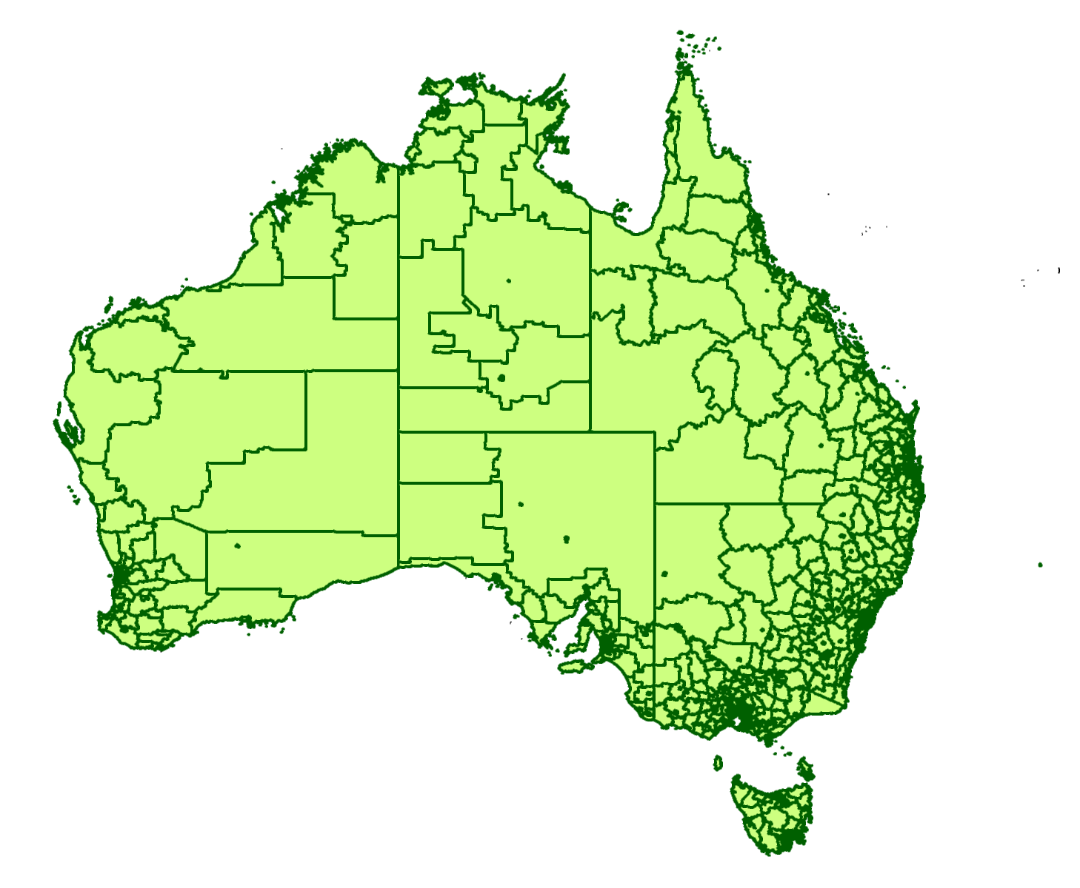
Queensland vs Australia: The challenges
}
More areas
Greater # observations
Oversmoothing would preclude later ecological analysis
MCMC -> INLA
CAR prior??

Slide 7
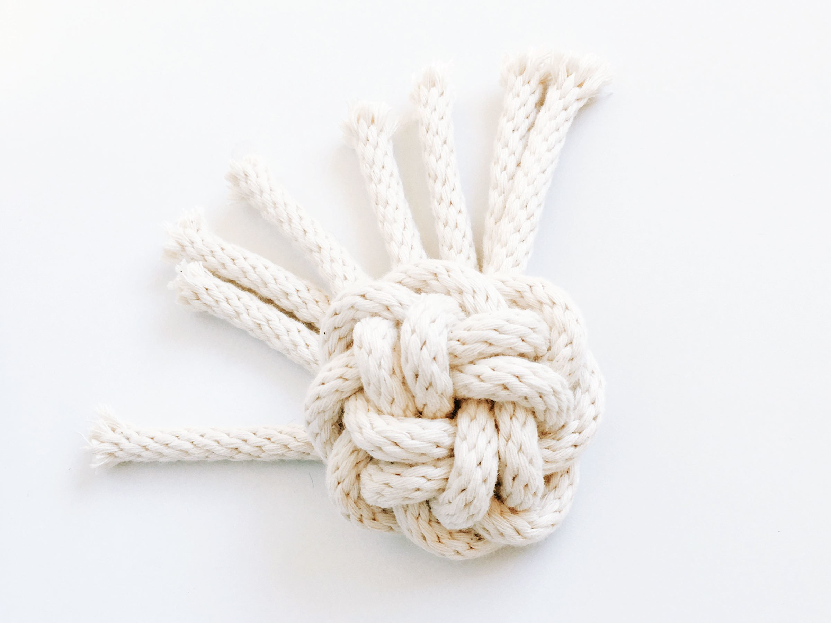
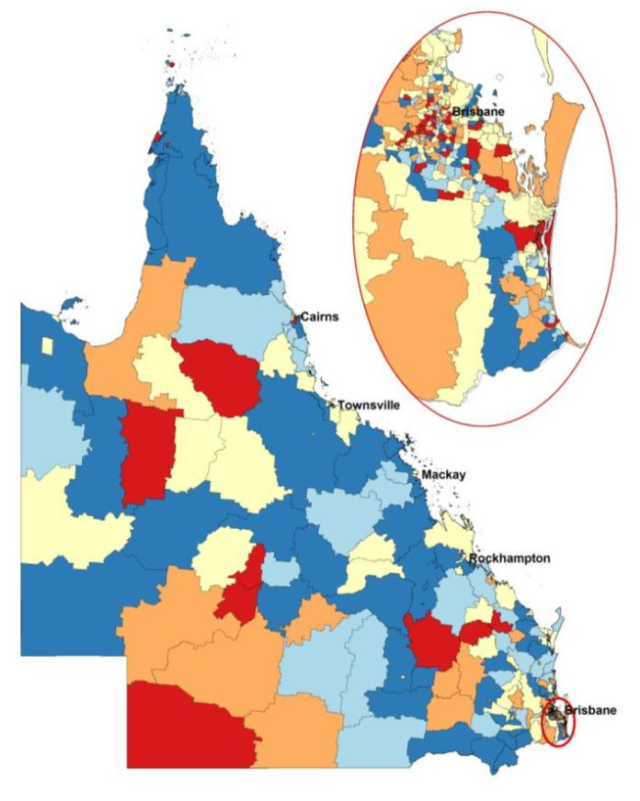
Knotty issues
Identifying oversmoothing
R-INLA capacity
rstpm2
INLA survival models

Slide 8
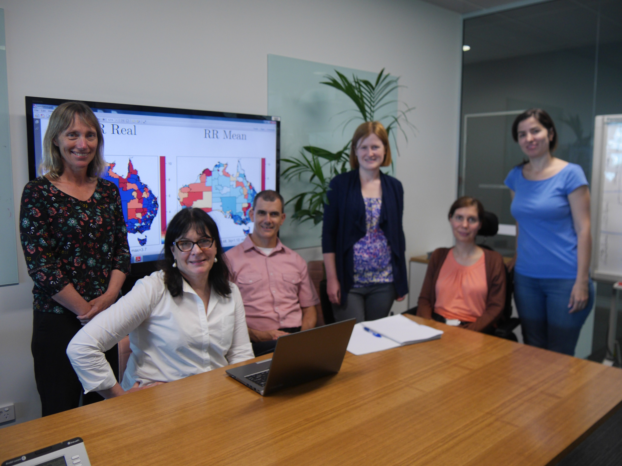
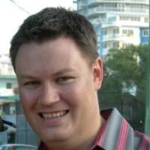
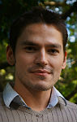
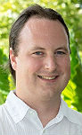
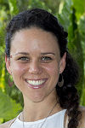
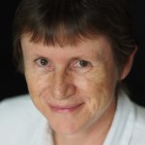
Thank you!
Notes:
From your left, our team is composed of Kerrie Mengersen, Joanne Aitken, Peter Baade, Nicole White, myself and Paula Moraga. Other team members include (click) Jessie Roberts, (click) Earl Duncan, (click) James McGree, (click) David Houslip and (click) Pamela Burrage. We believe this will be an exciting study, with great potential to influence health policy and bring benefit to cancer patients across the country. This is a 2 year project and we look forward to keeping you updated on progress.

